Slide 1
Recommendations
*For informational purposes only. Delete slides 1-5 after reading.
The first five slides (1-5) are meant to be an introduction to color accessibility and appropriate usage. These five slides can be deleted.
The remaining slides (6-11) are examples on how the templates can be used. Any slides that aren’t used should be deleted.
All slide design templates are available through the Layout menu.
We have setup our brand colors as the theme colors for the template. Please use our brand colors exclusively in your presentation.
If the presentation will be made available for view or download online, the creator should ensure the presentation meets accessibility standards. Please refer to Microsoft’s guide on how to make your presentation accessible by clicking here. Also refer to slide 2-5 for more information.
If you have questions regarding the visual identity of Louisiana Tech University, please contact University Communications at extension 4854.

Slide 2
Accessibility
*For informational purposes only. Delete slides 1-5 after reading.
At Louisiana Tech University, we have and always will be actively shaping an education and environment that’s innovative, impactful and inclusive.
When designing and developing our expressions and experiences, we consider the distinct perspectives and needs of all. The following slides show approved color combinations that meet our accessibility standards (WCAG 2.0 AA). When choosing typography and background colors, always promote visibility and legibility by ensuring sufficient contrast. Font sizes and weights also play a crucial role, which is why we’ve provided minimums for each color combination. For presentations, we recommend making sure that your text is sufficiently large so that the people in the back of the room can read it.
To test your design’s accessibility, we suggest proofing color pairs (text color versus background color) using a contrast calculator. A contrast ratio of 4.5:1 (Level AA of WCAG 2.0) is required for text.

Slide 3
Color Palette
*For informational purposes only. Delete slides 1-5 after reading.
Primary Colors
PMS 287 HEX #003087 RGB 0/48/135 | PMS 1797 HEX #CB333B RGB 203/51/59
Secondary Colors
PMS 295 HEX #002855 RGB 0/40/86 | PMS 292 HEX #64B1E7 RGB 101/178/232
PMS 429 HEX #A0AAB2 RGB 161/171/178 | PMS 430 HEX #727F8A RGB 114/128/138 | Black HEX #000000 RGB 0/0/0

Slide 4
Color Accessibility
*For informational purposes only. Delete slides 1-5 after reading.
Primary Colors—Large web text sizing (WCAG 2.0 AA defines large web text as 18.66px or larger and bold weight, or 24px or larger.)
Go Tech!
Go Tech!

Slide 5
Color Accessibility
*For informational purposes only. Delete slides 1-5 after reading.
Normal web text sizing (WCAG 2.0 AA defines normal web text as 18.66px or smaller.)
Primary Colors
Secondary Colors
Go Tech!
Text: #003087 Background: #FFFFFF
Go Tech!
Text: # FFFFFF Background: #002855
Go Tech!
Text: #FFFFFF Background: #A0AAB2
Go Tech!
Text: # FFFFFF Background: #003087
Go Tech!
Text: # FFFFFF Background: #64B1E7
Go Tech!
Text: #FFFFFF Background: #727F8A
Go Tech!
Text: #FFFFFF Background: #CB333B
Go Tech!
Text: #FFFFFF Background: #000000

Slide 6
Presentation title here
Your name or department

Slide 7
Presentation tile here
Your name or department

Slide 8
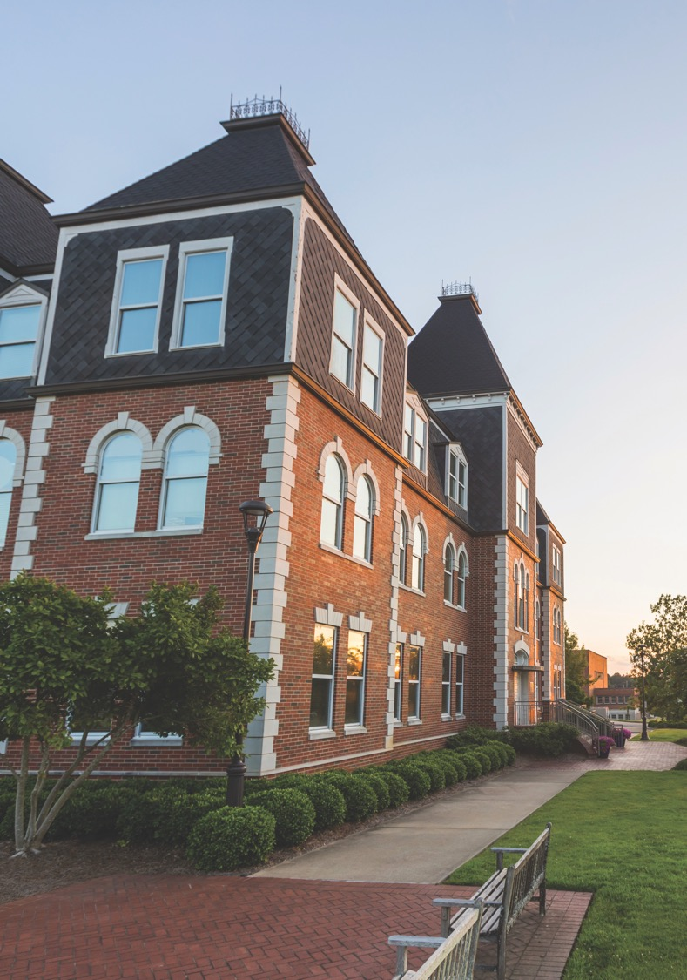

Slide 11
CLOSING TEXT
Your name
Your title
Your contact information

